Slide 1
Focal loss

Slide 2

Purpose of focal loss
Prevent loss function being overwhelmed by “easy negatives”

Slide 3
Proposed loss function
$$FL\left(p_{t}\right)= α_{t}{(1-)p_{t}}^{γ}$$$$(-\log{p_{t})}$$
$$y$$ is defined as the ground truth
$$p$$ is the predicted probability for a foreground class
$$p_{t} = \left\{\begin{aligned}p, if y=1 \\ 1-p, else\end{aligned}\right.$$

Slide 4

Tunable hyperparameters
Video

Slide 5
Tunable hyperparameters
 | Observation | Purpose
$$α$$ | Scales the whole loss function | Controls magnitude of overall loss
$$γ$$ | Reduces the values greater as $$x→1$$ | Controls ratio in loss contribution for easy and hard examples
Based on experiments, ideal

Slide 6
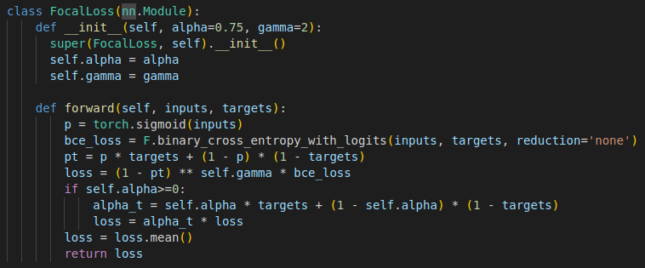
Implementation

Slide 7
Experimental Techniques
2 stage cascade
Biased sampling

Slide 8
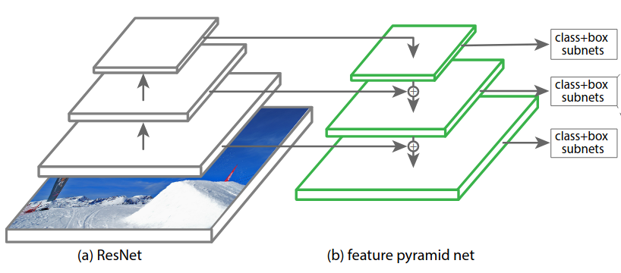
RetinaNet
Based on Feature Pyramid Network
Top down approach
Better preserves spacial details
Upscales lower resolution data
Data is combined by addition
Classification at multiple resolutions

Slide 9
Feature Pyramid Network
Layer $$p_{l}$$ has a resolution $$2^{l}$$ lower than the input
In application, they set the stride to be $$2^{l}$$
{ $$P_{3}$$ to $$P_{5}$$ } is trained using residual function using { $$C_{3}$$ to $$C_{5}$$ }
$$P_{6}$$ uses a 3x3 kernel with stride 2 on $$C_{5}$$
$$P_{7}$$ uses a 3x3 kernel with stride 2 on $$P_{6}$$

Slide 10
Feature Pyramid Network
Filters
Each layer has 256 channels
Each channel is an output after a filter has been applied
Behaves like a kernel

Slide 11

wtf is C

Slide 12
RetinaNet
Does a convolutional object classification
2. Does a bounding box regression

Slide 13
Tunable hyperparameters
 | $$\frac{∂}{∂α}$$ | $$\frac{∂}{∂γ}$$
$$y=1$$ | $$-{(1-p)}^{γ}\log{p}$$ | $$αln{(1-p)}$$$$(-{(1-p)}^{γ}\log{p})$$
$$y=-1$$ | $$p^{γ}\log{(1-p)}$$ | $$(α-1)ln{p}$$$$(p^{γ}\log{(1-p)})$$

Slide 14
Initialization
Hyperparameters are tested to find optimal value
$$α=0.75$$
$$γ=2$$

Slide 15
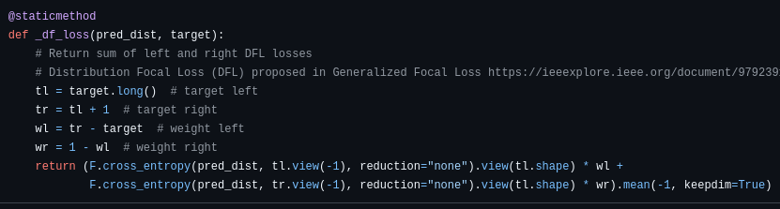
Applications
YOLOv8 – Distributed focal loss

Slide 16
Traditional loss for localization tasks
$$L_{loc} = \sum_{i}{SL(y_{i}-{\hat{y}}_{i})}$$
$$SL = \left\{\begin{aligned}L1=\sum_{i}{\left|y_{i}-{\hat{y}}_{i}\right|}, if \left(y_{i}-{\hat{y}}_{i}\right)<ε \\ L2 = \sum_{i}{{(y_{i}-{\hat{y}}_{i})}^{2}}, else\end{aligned}\right.$$

Slide 17
Applications
YOLO11 – Varifocal loss
Down-weights negative examples
Up-weights positive examples

Slide 18
Varifocal loss
$$VFL(p,q) = \left\{\begin{aligned}-q(q\log{p}+ (1-q)\log{(1-p)}) \\ -αp^{γ}\log{(1-p)}\end{aligned}\right.$$
If foreground, $$q=\frac{(predicted∩target)}{(predicted∪target)}$$
If background or $$Iou ≤ε$$, $$q=0$$

Slide 19
Limitations

